Slide 1
Business Sales Performance Dashboard
Interactive Dashboard Summary | Superstore Dataset

Slide 2
Dashboard Overview
This interactive dashboard provides business stakeholders with key insights into sales, profit, and customer segments across various regions and time periods. Designed using Power BI with the Superstore dataset.

Slide 3
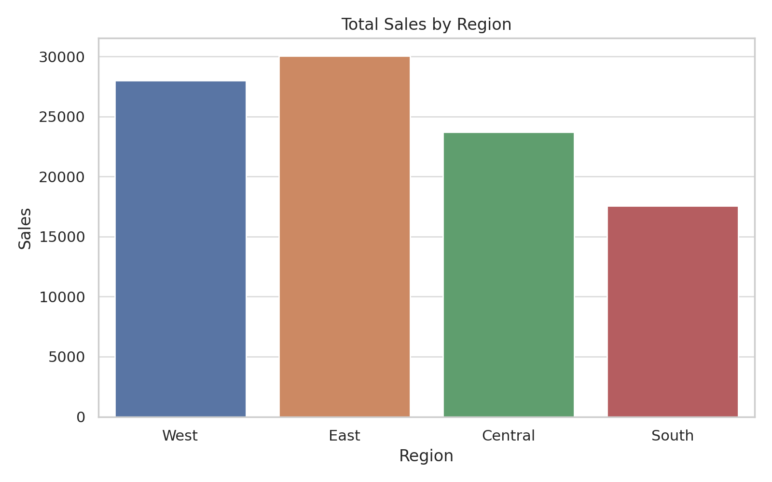
Total Sales by Region

Slide 4
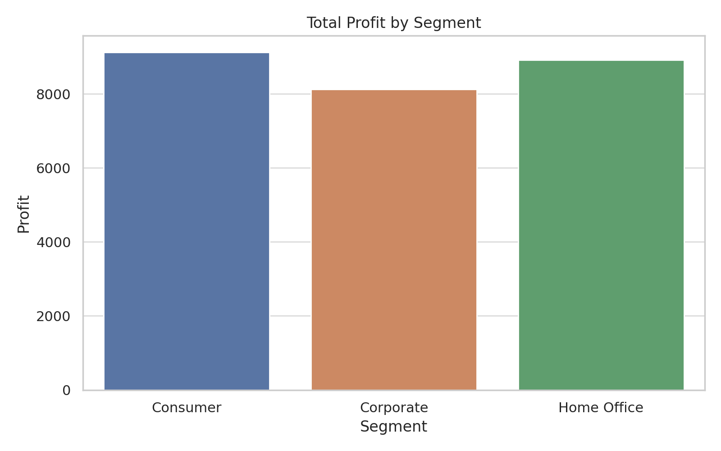
Total Profit by Segment

Slide 5
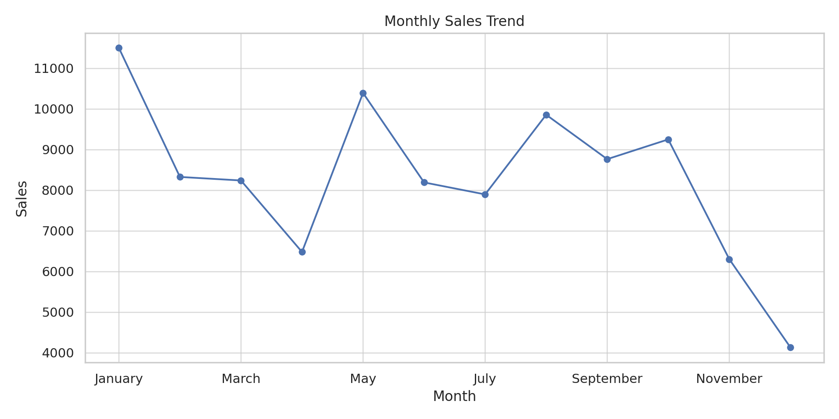
Monthly Sales Trend

Slide 6
Key Business Insights
- The West region shows the highest sales volume.
- Corporate and Consumer segments are more profitable.
- Monthly trends highlight seasonal demand fluctuations.
- Monitoring discount impacts on profit is crucial.
- Technology products dominate high sales values.

Slide 7
Conclusion & Recommendations
• Focus marketing efforts on high-performing regions and categories.
• Reevaluate discounts strategy to reduce losses.
• Enhance customer targeting in Corporate and Consumer segments.
• Utilize monthly trends for inventory and demand planning.

